Slide 1
CNN

Slide 2
Example
Two convolution + max pooling layers for feature extraction
One dense hidden layer for learning higher-level representations
Dropout to reduce overfitting
Softmax output layer for classification

Slide 3
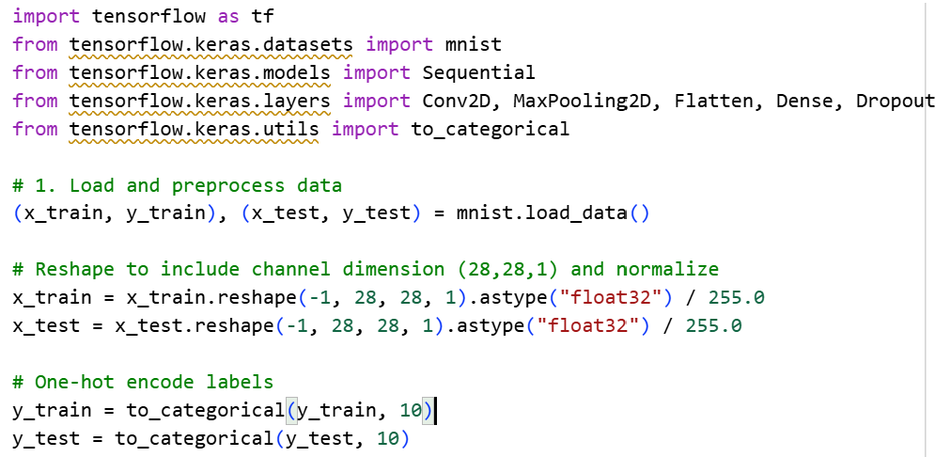

Slide 4
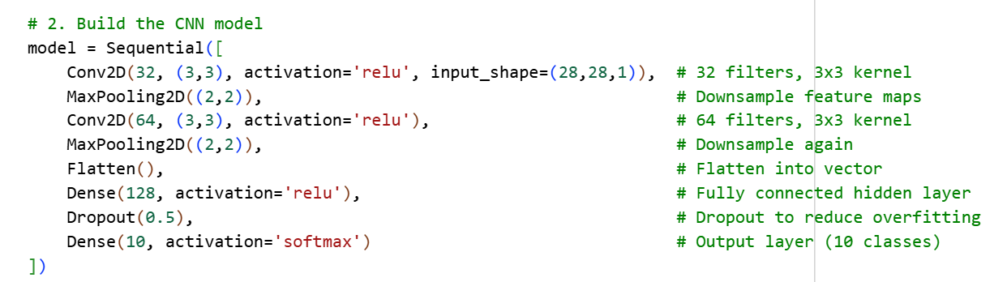
Conv1D → for sequences (like text, audio, time series). It slides along 1 dimension (time or sequence length).
Conv2D → for images, where you have 2 spatial dimensions (height, width).
Conv3D → for video or volumetric data (MRI scans), where you have 3 spatial dimensions (height, width, depth/time).

Slide 5
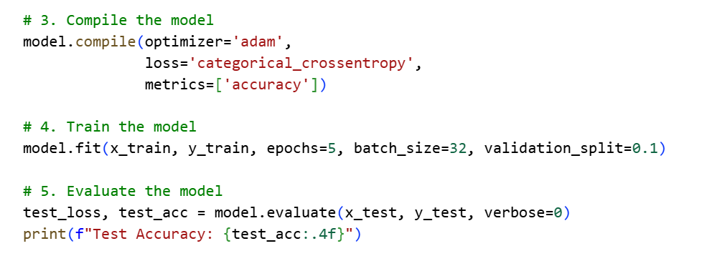

Slide 6
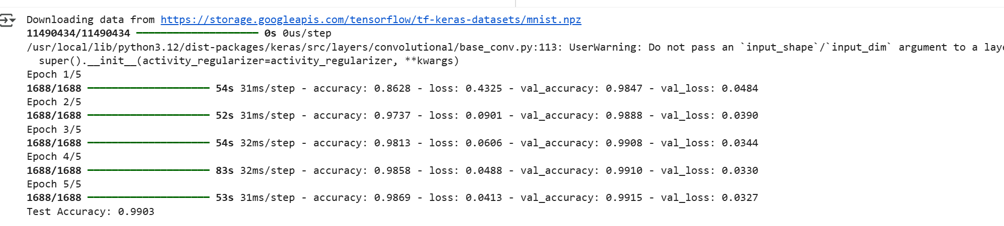

Slide 7
Pytorch

Slide 8
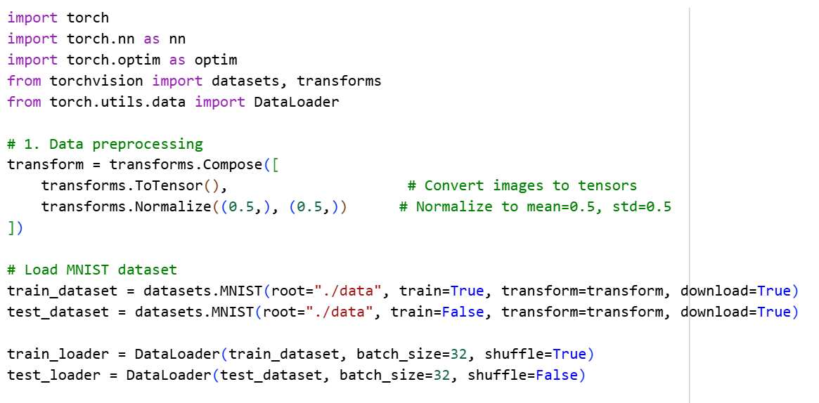

Slide 9
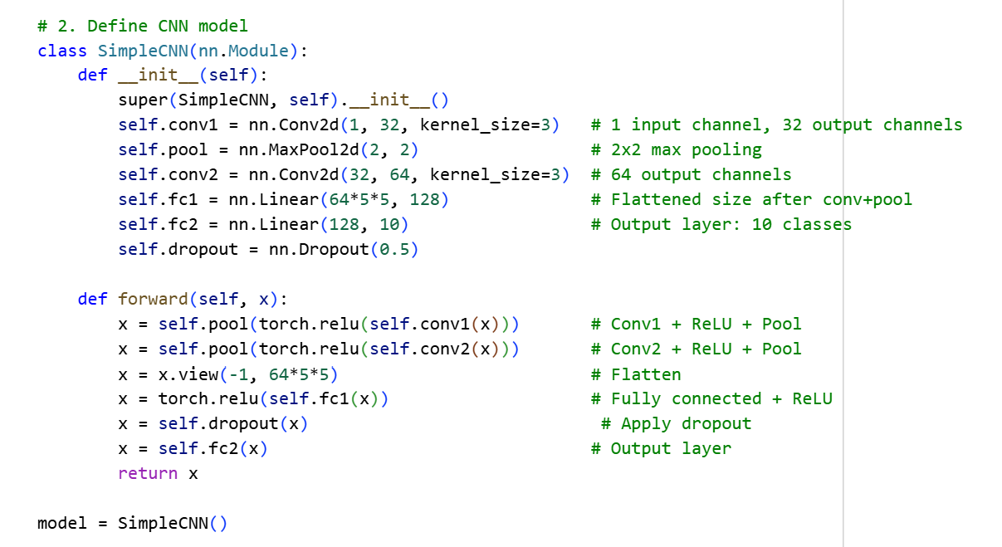

Slide 10
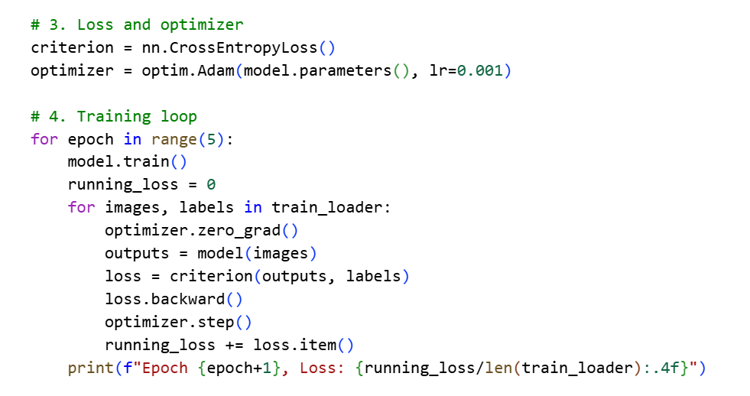

Slide 11
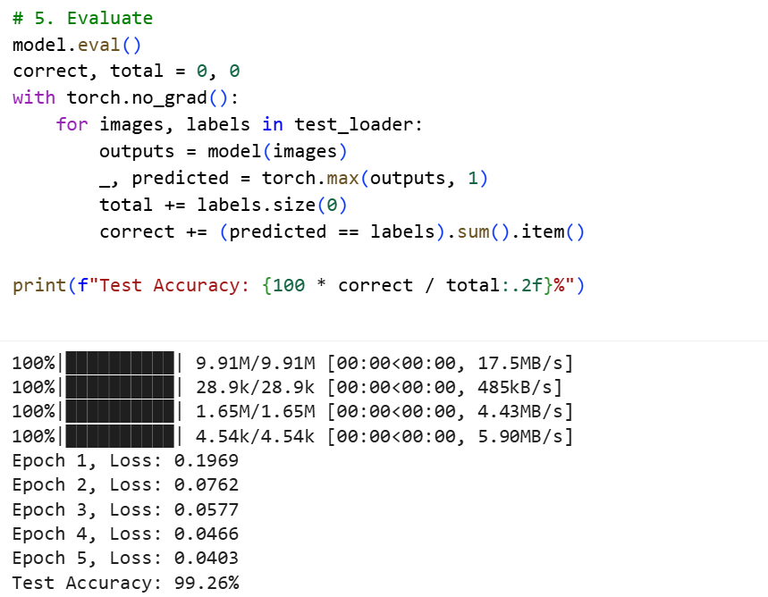

Slide 12
Implement CNN with CIFAR-10using TensorFlow / Keras:
Loads CIFAR-10 dataset
Preprocesses images
Builds a CNN
Trains and evaluates it
Tests on a sample image
Use:
3 convolutional layers
2 max pooling
fully connected layers.
softmax output layer for 10 CIFAR-10 classes.
Training takes ~5–10 minutes on CPU, much faster on GPU.??
Expected ~70% accuracy after 10 epochs

Slide 13
The CIFAR-10 dataset is
A widely used benchmark in machine learning for image classification,
consisting of 60,000 low-resolution (32x32 pixel) color images divided into 10 categories, such as "airplane", "cat", and "truck".
The dataset includes a standard split of 50,000 training images and 10,000 test images, allowing algorithms to learn from examples and be evaluated on their ability to recognize objects in unseen images

Slide 14
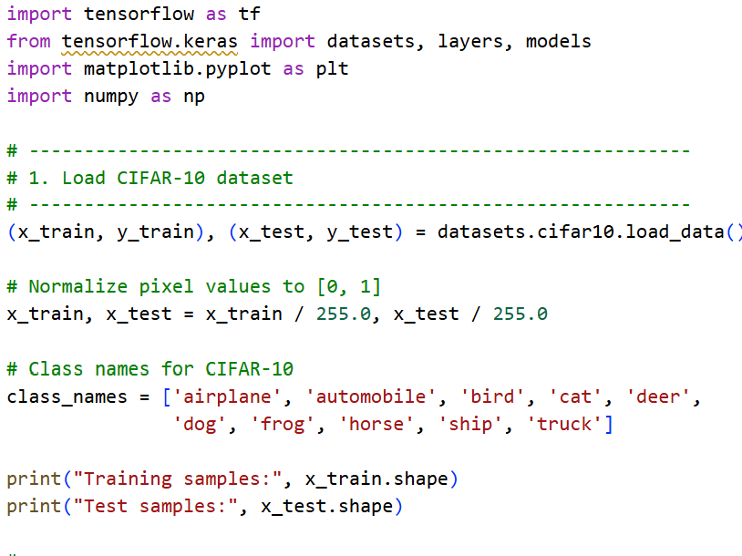

Slide 15
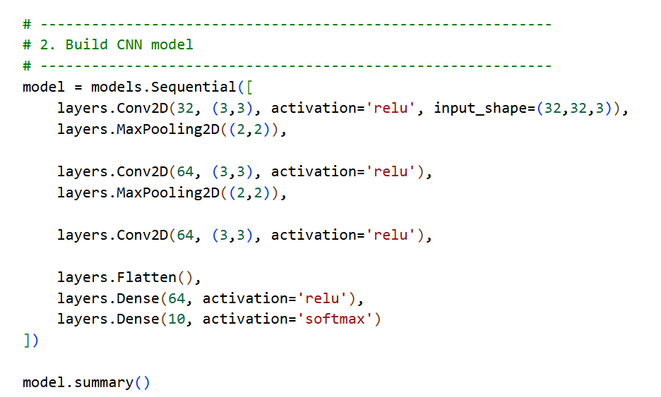
activation='relu’:turns negative values into 0, keeps positive values
➔Adds non-linearity so the network can learn complex features.
Conv2D(32, (3,3))➔Applies 32 filters.
Each filter is 3×3 in size.
Detects basic patterns: edges, corners, simple textures.
input_shape=(32,32,3)The input images are 32×32 pixels with 3 channels (RGB).
64 filters, 3×3 size → now the model learns more complex features (shapes, textures).
layers.Dense(64, activation='relu'),
A dense layer with 64 neurons.
Each neuron connects to all values from Flatten layer.
Learns combinations of features (e.g., “round + furry = cat”).
takes the 3D feature maps (6×6×64 = 2304 numbers) and flattens into a 1D vector
MaxPooling2D((2,2))Reduces spatial size (downsamples) by taking the max in every 2×2 block.
Cuts the image size in half (e.g., 32×32 → 16×16).Keeps important features while reducing computation.
layers.Dense(10, activation='softmax')
10 neurons = 10 classes in CIFAR-10 (airplane, car, bird, cat, deer, dog, frog, horse, ship, truck).
Softmax activation:
Converts outputs into probabilities that sum to 1.
Pooling again → reduces from 16×16 to 8×8 feature maps.
64 filters, 3×3.At this point, filters can detect higher-level features (like eyes, wheels, wings, etc.).

Slide 16
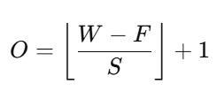
Why does MaxPooling shrink the size?
Pooling layers work by sliding a window (e.g. 2×2) across the feature map and taking the maximum (or average)
If you don’t overlap (stride = 2), every 2×2 block is replaced by 1 value. This reduces both height and width by half.
Input size: 30 × 30
Pool size: 2 × 2
Stride: 2 =➔ (30-2)/2 +1 =15
where:
W = input size (width or height)
F = filter (pooling window) size
S = stride (step size)

Slide 17
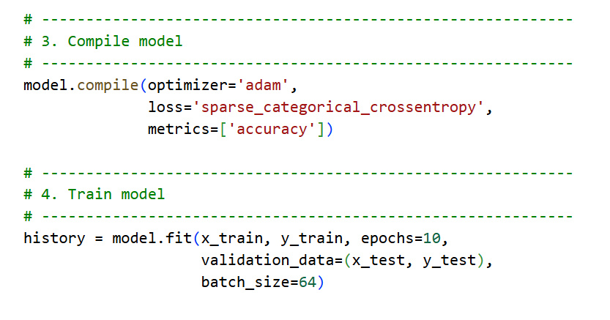

Slide 18
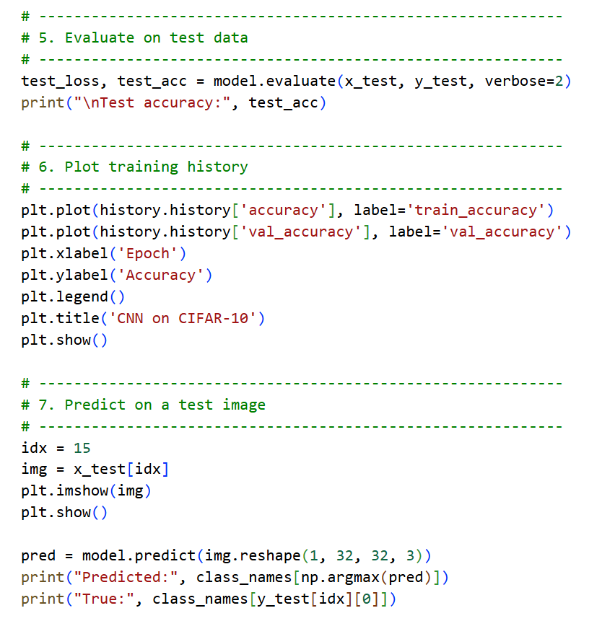

Slide 19
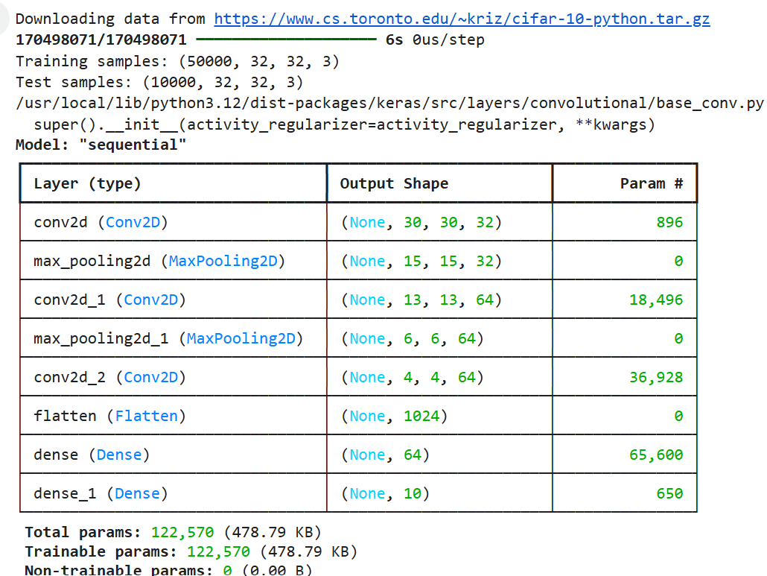
What happens:32 filters, each of size 3×3×3 (RGB channels).Each filter has 3×3×3 = 27 weights + 1 bias = 28 parameters.Total = 32 × 28 = 896 parameters.
Why 30×30?Input was 32×32, a 3×3 filter reduces it to 30×30 (no padding).Output: 32 feature maps (one per filter).
64 filters, each 3×3×32 (since input has 32 channels).Each filter has 3×3×32 = 288 weights + 1 bias = 289.Total = 64 × 289 = 18,496 parameters.Output shrinks from 15×15 → 13×13 because no padding.
Reduces spatial dimensions by 2 (30→15).Still 32 feature maps, no new parameters.
Again halves the dimensions (13→6).
Still 64 feature maps. (from pooling to conv 6-3+1 =4)

Slide 20
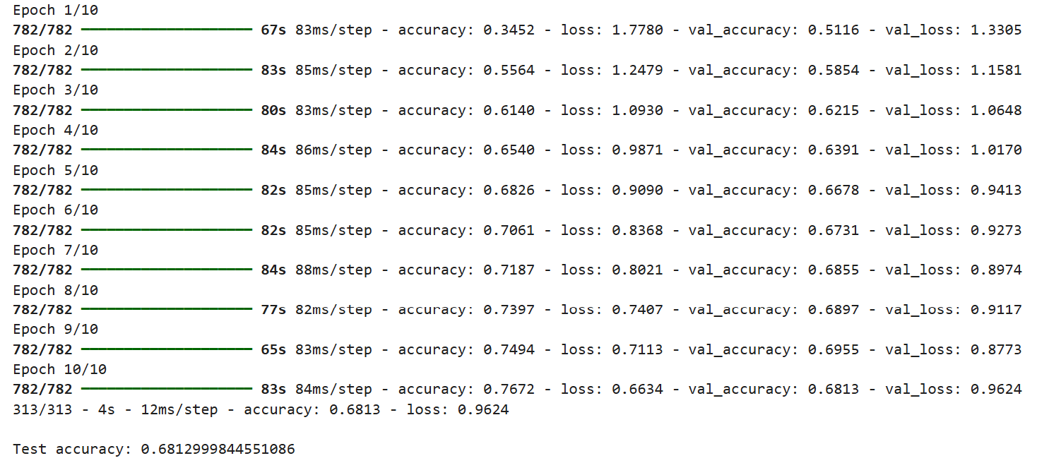

Slide 21
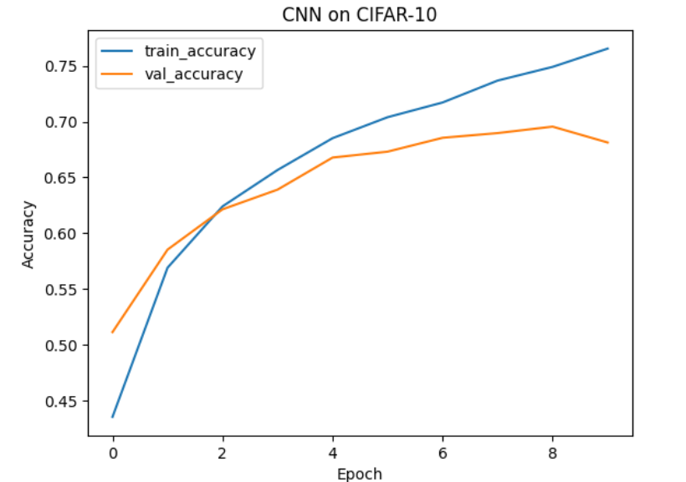
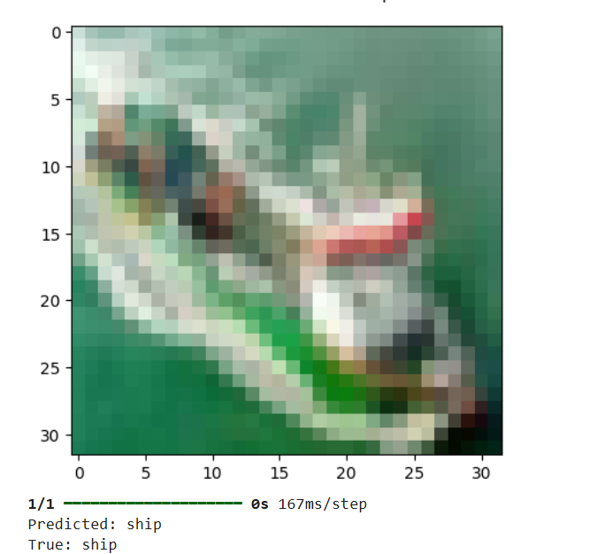

Slide 22
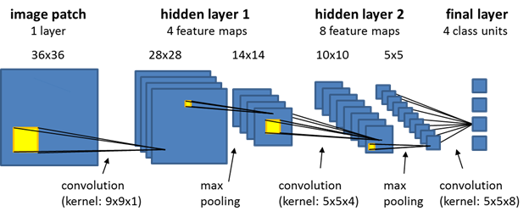
Summary of Flow
Conv Layers → extract local patterns (edges, textures).
Pooling Layers → reduce size, keep essential info.
Deeper Conv Layers → learn abstract features (shapes, object parts).
Flatten → convert feature maps into a vector.
Dense Layer → learn feature combinations.
Output Layer (Softmax) → probability distribution over classes.

